Slide 1
The Social Security Earnings Test and Retirement: New Evidence from Behavior Near the Exempt Amount
Discussion at the 16th RRC Meeting
Washington, DC
August 7-8, 2014
April Yanyuan Wu

Slide 2
Does labor supply respond to the Social Security earnings test?
Motivation
Pension incentives could cause substantial labor supply responses (Gruber and Wise 2004).
How the Social Security earnings test influenced retirement patterns has proven to be a complex topic to analyze (Brown et al. 2013).
Research question
Whether sharp change in benefit reduction at the exempt amount leads to a similar sharp change in retirement pattern.
Methods
Focus on extensive margin
Regression kink design

Slide 3
Does labor supply respond to the Social Security earnings test?
Findings
Clear visual and statistical evidence of kink in participation graph at exempt amount
Estimate that participation elasticity is 1.40
The earnings test causes retirement under full retirement age

Slide 4
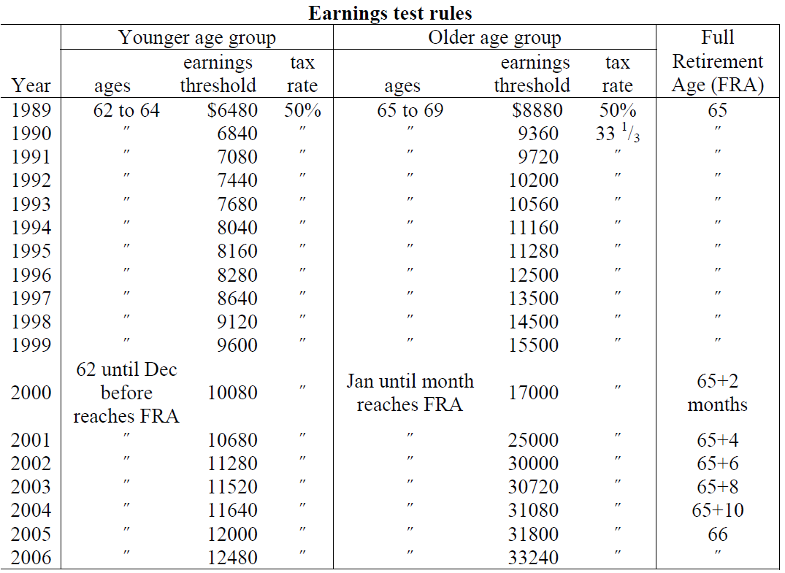
Background of the Social Security earnings test
The Social Security earnings test has been in place virtually since the system’s inception.
It has been a moving target, changing in important ways over time.
Author’s adoption from Friedberg and Webb (2006)

Slide 5
Background of the Social Security earnings test
The earnings test is actually not a tax.
Nevertheless, the earnings test could affect labor supply decisions:
Shorter expected lifespan
Liquidity constrained
Misunderstand
It is one of the least understood aspects of the Social Security system (Gruber and Orszag 1999).

Slide 6
What I like about this study
Clearly framed research questions
A clear theoretical frame work
An innovative approach
Credible documentation of behavioral responses
Suitable datasets
Administrative data allow large sample sizes and are subject to little measurement error.

Slide 7
Things worth a consideration
How big is the impact?
New evidence of labor supply distortion => a cost/benefit evaluation? (Gruber and Orszag, 1999)
The mechanism of the impact
Interaction between spouses
Heterogeneity among the sample
Measurement error concerns? Calendar year earnings but the earning test applies only to months after individual claims

Slide 8
Moving forward
The rationale for the earnings test?
One must retire in order to receive a retirement benefit because loss of earnings due to retirement is the insured condition
A tactic to induce older workers to leave the job market, thus making ways for younger worker
Forced saving to reduce poverty among the very old
Prevent higher rates of early benefit claiming
The magnitude of the labor supply distortion
Educate older workers the saving aspects of the earnings test (Brown et al. 2013)
More broadly, educate people about the system that a large majority of older Americans relies on for all or most of their retirement income

