Slide 1
How Do Subjective Longevity Expectations Influence Retirement Plans?
Matthew S. Rutledge, Mashfiqur R. Khan, and April Yanyuan Wu
Center for Retirement Research at Boston College and Mathematica Policy Research
16th Annual Meeting of the Retirement Research Consortium
Washington, DC
August 8, 2014

Slide 2
Are expectations about retirement and longevity linked?
Working longer is essential for improving retirement security.
Life expectancy at age 65 has increased by 4 years since 1980.
Longer lifetimes should result in later retirement.
More years of consumption to support.
More healthy years to continue working.

Slide 3
The link is surprisingly unclear.
Inconsistent evidence that individuals planning to live longer actually retire later.
Mostly focused on actual retirement behavior.
Hurd et al. (2004), Delavande et al. (2006): shortest-lived retire or claim early
O’Donnell et al. (2008): shortest-lived less likely to retire
Hamermesh (1984), Bloom et al. (2006): no relationship
Little is known about updating retirement expectations with new information (e.g., from a parent’s death or continued survival).

Slide 4
Our contribution
Examine relationship between longevity expectations and both planned and actual retirement age and working at older ages.
Retirement expectations should better reflect desired labor supply; later shocks can cause behavior to deviate.
Only van Solinge and Henkens (2009) and Szinovacz et al. (2014) link the two expectations.
Investigate how the change in survival expectations alters retirement expectations.

Slide 5
Measuring longevity expectations
Sample: Health and Retirement Study (HRS) respondents in 1992-2010 waves, ages 50-61, who are still in labor force
Longevity measure: Difference between subjective and objective life expectancy (SLE – OLE)
SLE: Self-assessed probability of living to 75 or 85
OLE: Actuarial estimation of living to 75 or 85 by birth cohort and sex
Also use SLE by itself in alternate specifications

Slide 6
Subjective life expectancy varies widely.
Worker Estimates of Their Likelihood of Living to Ages 75 and 85, by SLE Tercile
Source: Mashfiqur R. Khan, Matthew S. Rutledge, and April Yanyuan Wu. 2014. “How Do Subjective Longevity Expectations Influence Retirement Plans?” Working Paper 2014-1. Center for Retirement Research at Boston College.
5

Slide 7
Estimating the link between expectations
Dependent variable in linear regression is the self-assessed:
Retirement age
Probability of working full-time at or after 62
Probability of working full-time at or after 65
Control for characteristics that affect retirement behavior.
In some specifications, include individual fixed effect.
Captures longevity expectation updates

Slide 8
Measurement error and endogeneity
Two concerns:
Focal points like 0, 0.5, and 1 in probability responses
Unobserved factors correlated with both expectations (e.g., optimistic person overestimates survival, labor supply at older ages).
Estimate instrumental variable (IV) model
Instrument: each parent’s current age or age at death
Correlated with own survival (Hurd and McGarry 1995, 2002)
Not correlated with retirement except through survival (Bloom et al. 2006)
First-stage F test: 15.9 for age 75, 14.0 for age 85

Slide 9
Summary statistics
Selected Summary Statistics for the Static Model Sample
 |  |  | Tercile of SLE-OLE at 75
 | All |  | Low |  | Medium |  | High
Age (years) | 54.1 |  | 54.3 |  | 53.8 |  | 54.2
Expected retirement age (years) | 63.1 |  | 62.9 |  | 63.0 |  | 63.4
Expected Pr(working full-time at or after 62) (%) | 47.8 |  | 42.7 |  | 48.0 |  | 52.8
Expected Pr(working full-time at or after 65) (%) | 27.9 |  | 23.6 |  | 28.3 |  | 32.1
SLE at 75 (%) | 67.6 |  | 36.7 |  | 71.5 |  | 94.5
SLE at 85 (%) | 47.0 |  | 21.2 |  | 49.3 |  | 70.5
SLE-OLE at 75 (%) | -2.3 |  | -34.3 |  | 1.2 |  | 26.3
SLE-OLE at 85 (%) | 5.2 |  | -22.5 |  | 6.6 |  | 31.6
Sample size | 7,105 |  | 2,284 |  | 2,358 |  | 2,315
Source: Mashfiqur R. Khan, Matthew S. Rutledge, and April Yanyuan Wu. 2014. “How Do Subjective Longevity Expectations Influence Retirement Plans?” Working Paper 2014-1. Center for Retirement Research at Boston College.

Slide 10
SLE and retirement plans
Results of Regressions of Retirement Expectations on Subjective Life Expectancy
 | SLE-OLE at 75 |  |  |  |  |  |  | SLE-OLE at 85
 | OLS |  | FE |  | IV |  |  | OLS |  | FE |  | IV
Expected retirement age | 0.007 | *** | 0.002 | * | 0.014 | ** |  | 0.007 | *** | 0.003 | ** | 0.012 | **
N | 17,775 |  |  |  |  |  |  | 13,134
Plan to work full-time at or after 62 | 0.151 | *** | 0.106 | *** | 0.168 | ** |  | 0.123 | *** | 0.078 | *** | 0.167 | ***
N | 34,245 |  |  |  |  |  |  | 24,971
Plan to work full-time at or after 65 | 0.142 | *** | 0.082 | *** | 0.209 | *** |  | 0.157 | *** | 0.097 | *** | 0.204 | ***
N | 34,169 |  |  |  |  |  |  | 24,921
Note: *** p<0.01, ** p<0.05, * p<0.1.
Source: Mashfiqur R. Khan, Matthew S. Rutledge, and April Yanyuan Wu. 2014. “How Do Subjective Longevity Expectations Influence Retirement Plans?” Working Paper 2014-1. Center for Retirement Research at Boston College.

Slide 11
SLE and retirement plans (cont’d)
Estimated Effect of Swing from Median to Highest Tercile of Longevity Expectation on Retirement Plans
Source: Mashfiqur R. Khan, Matthew S. Rutledge, and April Yanyuan Wu. 2014. “How Do Subjective Longevity Expectations Influence Retirement Plans?” Working Paper 2014-1. Center for Retirement Research at Boston College.

Slide 12
SLE and actual retirement decisions
Results of Regressions of Retirement Expectations/Actual Retirement Behavior on SLE
 | SLE-OLE at 75 |  |  |  |  |  |  |  |  | SLE-OLE at 85
 | Expected |  |  |  | Actual |  |  |  |  | Expected |  |  |  | Actual
 | OLS |  | IV |  | OLS |  | IV |  |  | OLS |  | IV |  | OLS |  | IV
Retirement age | 0.004 | ** | 0.031 | ** | 0.001 |  | 0.005 |  |  | 0.002 |  | 0.015 | * | 0.003 |  | 0.002
N | 2,590 |  |  |  |  |  |  |  |  | 2,571
Working full-time at or after 62 | 0.158 | *** | 0.227 | * | 0.018 |  | 0.069 |  |  | 0.125 | *** | 0.221 | ** | 0.045 | ** | 0.120
N | 6,290 |  |  |  |  |  |  |  |  | 6,232
Working full-time at or after 65 | 0.163 | *** | 0.270 | ** | 0.075 | *** | 0.249 | * |  | 0.162 | *** | 0.271 | *** | 0.076 | *** | 0.219 | *
N | 5,152 |  |  |  |  |  |  |  |  | 5,110
Note: *** p<0.01, ** p<0.05, * p<0.1.
Source: Mashfiqur R. Khan, Matthew S. Rutledge, and April Yanyuan Wu. 2014. “How Do Subjective Longevity Expectations Influence Retirement Plans?” Working Paper 2014-1. Center for Retirement Research at Boston College.

Slide 13
Conclusion
Individuals who are more optimistic about living to ages 75 or 85 (relative to actuarial projections) have:
later planned retirement dates; and
higher probabilities of working FT at 62 and 65.
As individuals learn more about their longevity, they update their retirement expectations in the same direction.
SLE also influences actual retirement behavior, though to a lesser degree than with retirement expectations.

Slide 14
Policy implications
Not everyone is inappropriately pessimistic about longevity.
Low-income: weaker longevity gains, so a smaller increase in retirement age
But many underestimate the chance they’ll live to very old age.
Retiring too early
Under-saving
Underinsuring for long-term care
Further gains in retirement age may require educating the overly pessimistic.

Slide 15
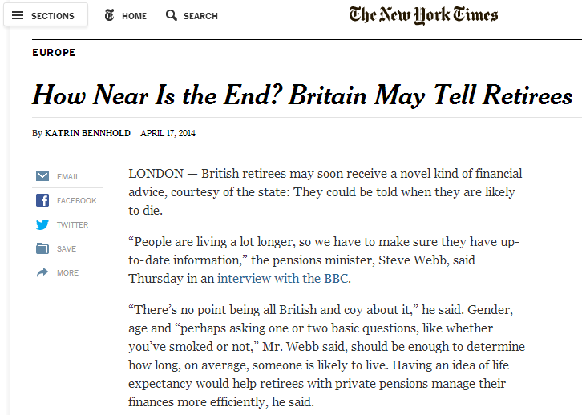
Can public policy help?
Source: The New York Times. April 17, 2014. “How Near Is the End? Britain May Tell Retirees.”

