Slide 1
How Do Public Pensions Affect Retirement Incomes and Expenditures? Evidence over Five Decades from Canada Kevin Milligan Vancouver School of Economics and NBER kevin.milligan@ubc.ca David A. Wise Harvard University and NBER david_wise@nber.org

Slide 2
Motivation
What impact does public pension income have on wellbeing?
Does public pension expansion just crowd out own sources? Or increase income and consumption?
Insurance: provides insurance that (perhaps) can’t be bought in markets
Long-life.
Bad investments; untimely shock.
Low lifetime earnings.
Planning problems: Cognitive biases / lack of foresight leads to undersaving

Slide 3
Question:
Have more generous public pensions led to higher incomes and expenditures and lower poverty?

Slide 4
Advantages of this paper:
Uses data from Canada which brings two advantages over existing work
More extensive institutional variation
introduction of main earnings-related pension from 1966 onward
periodic expansions of income-tested pensions.
Long, comparable income and expenditures data series.
Spanning period 1969 to 2010
Can use this to simulate results over a five-decade span; 1960 to 2010.

Slide 5
Outline:
Brief institutional background.
Long-run trends.
Empirical approach
Main Results
Simulations

Slide 6
Institutional Background
Three main building blocks of the system
OLD AGE SECURITY
Since 1953
Eligibility: Age 70 until 1966, then transition to age 65.
Flat benefit; current amount is $551/month.
GUARANTEED INCOME SUPPLEMENT
Since 1967; expanded 1971, 1979-80, 1984, 2000.
Income-tested at couple level; about 1/3 of those 65+ receive.
Current amount: $747/month.
CANADA PENSION PLAN
Contributory, earnings-related plan introduced in 1966.
Flat 25% replacement rate—no progressive structure like Social Security.
Phased in from 1967-76; in 1990 those over 79 didn’t have full coverage

Slide 7
Outline:
Brief institutional background.
Long-run trends.
Empirical approach
Main Results
Simulations

Slide 8
Figure 1: Poverty Measures by Year
Expenditure Relative Poverty: Take median of working age population expenditures. Set line at 50% of median.
Income Relative Poverty: Take median of working age population income. Set line at 50% of median.
Low Income Cutoff (LICO): Fixed income cutoff set in 1992; updated annually for inflation.

Slide 9
Figure 2: Relative Income Poverty by Decade
Income Relative Poverty: Take median of working age population income. Set line at 50% of median.

Slide 10
Outline:
Brief institutional background.
Long-run trends.
Empirical approach
Main Results
Simulations

Slide 11
Empirical Approach
Exploit the variation across ages and years.
An 80 year old will have different benefits in 1977, 1987, 1997, 2007.
In 1987, there will be different benefits at ages 60, 70, 80, 90.
Benefit income in an age-year depends on four things
Earnings history (for CPP earnings-related)
Non-labor income (For GIS income-tested)
Family structure (Married, single, marital age gap)
Set of retirement probabilities.

Slide 12
Empirical Approach
Strategy:
Simulate using a fixed set of inputs (i. to iv. above).
All differences across age-year cells driven by rule differences.
Use these age-year cells as instruments.

Slide 13
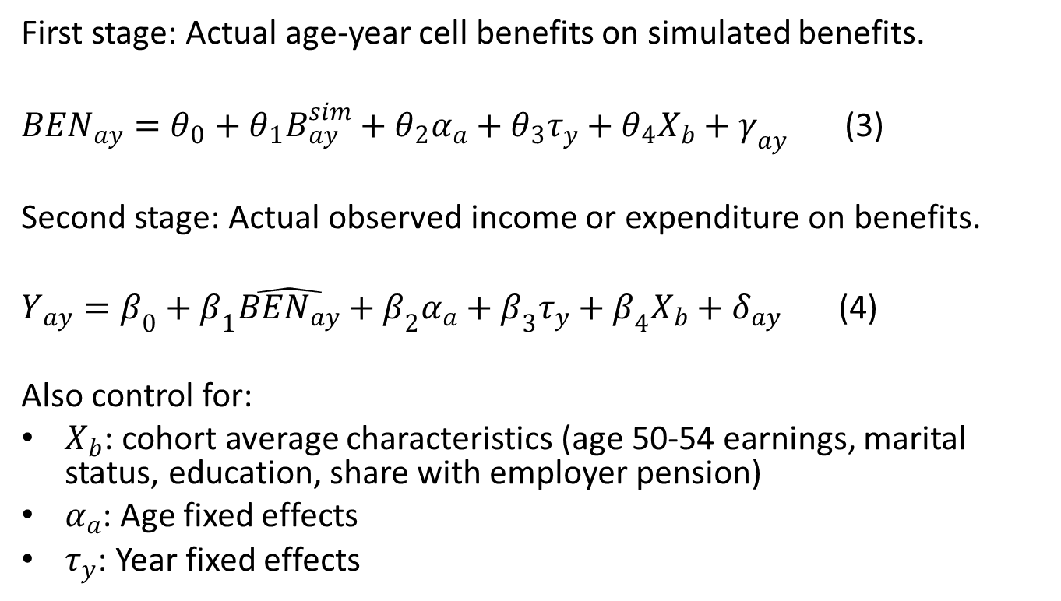
Regression specification:
First stage: Actual age-year cell benefits on simulated benefits.
${BEN}_{ay}=θ_{0}+θ_{1}B_{ay}^{sim}+θ_{2}α_{a}+θ_{3}τ_{y}+θ_{4}X_{b}+γ_{ay}$ (3)
Second stage: Actual observed income or expenditure on benefits.
$Y_{ay}=β_{0}+β_{1}\hat{{BEN}_{ay}}+β_{2}α_{a}+β_{3}τ_{y}+β_{4}X_{b}+δ_{ay}$ (4)
Also control for:
$X_{b}$: cohort average characteristics (age 50-54 earnings, marital status, education, share with employer pension)
$α_{a}$: Age fixed effects
$τ_{y}$: Year fixed effects

Slide 14
Simulated Benefits fit well:

Slide 15
Lots of age-year variation in benefits:

Slide 16
Outline:
Brief institutional background.
Long-run trends.
Empirical approach
Main Results
Simulations

Slide 17
Table 1: Income Regressions

Slide 18
Table 2: Expenditure Regressions

Slide 19
Outline:
Brief institutional background.
Long-run trends.
Empirical approach
Main Results
Simulations

Slide 20
Simulations:
Consider a counterfactual:
What if we applied the benefit levels of different decades to data from the 2000s?
Consider the pension system of 1960, 1970, 1980, 1990, 2000, 2010.
Will try this out using poverty estimates for income and expenditure.

Slide 21
Table 3: Public Pension Eligibility at Different Ages Across the Decades
Year | Old Age Security | Guaranteed Income Supplement | Canada Pension Plan
1960 | Age 70 | Not available | Not available
1970 | Age 65 | Age 65+, small size | Age 65 40% phased in Survivor benefit before 65
1980 | Age 65 | Age 65+, medium size Allowance 60-64 | Age 65 Fully phased in Survivor benefit before 65
1990 | Age 65 | Age 65+, full size Allowance 60-64 | Age 60 with adjustments Fully phased in Survivor benefit before 65
2000 | Age 65 | Age 65+,full size Allowance 60-64 | Age 60 with adjustments Fully phased in Survivor benefit before 65
2010 | Age 65 | Age 65+, full size Allowance 60-64 | Age 60 with adjustments Fully phased in Survivor benefit before 65

Slide 22
Figure 5: Counterfactual Relative Income Poverty Rates under Systems of Different Years

Slide 23
Conclusions:
We study the expansion of Canadian public pensions over five-decade period.
Three major findings:
Public pension benefits have strong effect on income and expenditure deprivation.
Pension benefits have affected incomes more at the bottom than the top.
Canadian policy expansion led to large decreases in deprivation:
Income poverty: 88 percent drop for 70 to 70 year olds in 2010 vs. 1960 system.

