Slide 1
How Do Various Social Security Changes Affect Retirement and Consumption?
Wenliang Hou and Geoffrey T. Sanzenbacher
Center for Retirement Research at Boston College
19th Annual Retirement Research Consortium Meeting
Washington, DC
August 4, 2017

Slide 2
Introduction to project
A variety of proposed changes could improve the finances of Social Security.
But while these changes can have a similar financial impact, as estimated by Social Security’s actuaries, their effect on individual behavior and welfare will vary.
This project uses the Gustman and Steinmeier structural model to evaluate the behavioral and welfare impact of changes that have similar effects on Social Security’s bottom line.

Slide 3
Structural econometric models present a way to analyze behavioral and welfare effects.
Structural models begin with assumptions on workers’ utility function, choice set, and financial constraints.
The parameters of workers’ utility functions are estimated based on observed choices given their constraints.
For example, if workers in poor health retire before Social Security eligibility, it implies a strong disutility from work.

Slide 4
In these models, researchers can simulate behavior under alternative constraints.
Continuing the earlier example, imagine the effect on sick workers of delaying the early eligibility age:
Some may work longer to avoid years of low income.
Others, with some retirement savings, might stop working anyway.
This example illustrates how policy experiments can play out in the model.

Slide 5
Will present the results of the effects of three changes to the Social Security program.
Raising the Full Retirement Age (FRA) to 69.
Reducing the cost-of-living adjustment (COLA) by 0.5 percentage points.
Increasing the employee portion of the payroll tax to 7.75 percent.

Slide 6
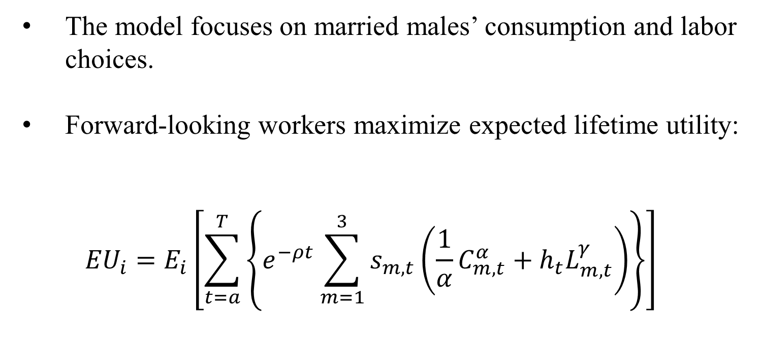
This project uses the Gustman and Steinmeier (2006, 2009) structural model.
The model focuses on married males’ consumption and labor choices.
Forward-looking workers maximize expected lifetime utility:
$${EU}_{i}=E_{i}\left[\sum_{t=a}^{T}{\left\{e^{−ρt}\sum_{m=1}^{3}{s_{m,t}}\left(\frac{1}{α}C_{m,t}^{α}+h_{t}L_{m,t}^{γ}\right)\right\}}\right]$$
Time discounting
Utility of consumption
Probability of living
Disutility of labor

Slide 7
Workers’ assets today depend on their past consumption and labor force decisions.
Assets at t
Labor income
Spouse’s income
Consumption
$$A_{t}=\left(1+r_{t}\right)A_{t−1}+W_{t}\left(1−L_{m,t}\right)+ E_{m,t}+ B_{m,t}− C_{m,t}$$
Realized
rate of return
Labor choice
(Full, part, none)
Social Security and pension income

Slide 8
Pensions and Social Security benefits, B_{m,t}, are especially important parts of the model.
Individuals are assumed to claim Social Security as soon as earnings fall below the earnings test.
This links the decision to cease working with claiming.
The benefit reflects the actuarial reduction or delayed retirement credit at the time of claiming.
DB pension wealth accumulates based on actual plan rules, which often reflect strong incentives to work to a certain age.

Slide 9
Internal Validation: The model fits the behavior of those it was estimated on well.
Share of Sample Completely Retired, Ages 50-64, HRS Cohort
Source: Authors’ calculations from HRS and Gustman and Steinmeier (2006).

Slide 10
Checking that the model accurately predicts changes in behavior is important too.
“External validation” checks to see if the model can predict changes that have already happened.
Sanzenbacher et al. (2017) examine how well the model predicted the effect of four changes:
Improving health;
Improving mortality;
Increases in the FRA; and
The shift to DC plans.

Slide 11
External Validation: The model predicts the responses to these changes well.
Share of Sample Completely Retired Ages 50-69, by Cohort
Source: Authors’ calculations from HRS and Gustman and Steinmeier (2006).

Slide 12
Estimating the distributional effects of reforms requires a baseline policy.
The Gustman and Steinmeier model’s “baseline” policy uses Social Security rules for the 1931-1941 birth cohorts.
But the reforms being considered start with the current legislative environment.
This paper uses as its baseline policy an FRA of 67, a DRC of 8 percent per year, and no earnings test over the FRA.
The baseline assumes benefit schedule as under current law.

Slide 13
The model predicts benefit reductions affect retirement timing more than tax increases.
Percent Change in Share Completely Retired under Various Policies
 | Share completely retired |  |  |  |  |  |  |  |  | Percent change from baseline
Age | Baseline |  | FRA 69 |  | COLA reduction |  | Tax increase |  |  | FRA 69 |  | COLA reduction |  | Tax increase
62 | 42.6 | % | 40.8 | % | 41.7 | % | 42.6 |  | % | -4.2 | % | -2.0 | % | 0.1 | %
63 | 46.8 |  | 45.0 |  | 45.9 |  | 46.9 |  |  | -3.9 |  | -2.1 |  | 0.1
64 | 49.8 |  | 49.7 |  | 48.8 |  | 49.9 |  |  | -0.3 |  | -2.0 |  | 0.2
65 | 55.0 |  | 54.5 |  | 53.8 |  | 55.1 |  |  | -0.8 |  | -2.0 |  | 0.2
66 | 59.5 |  | 56.9 |  | 58.3 |  | 59.7 |  |  | -4.4 |  | -2.1 |  | 0.2
67 | 63.0 |  | 61.5 |  | 61.4 |  | 63.2 |  |  | -2.3 |  | -2.5 |  | 0.3
68 | 66.6 |  | 65.3 |  | 65.0 |  | 66.8 |  |  | -2.0 |  | -2.4 |  | 0.3
69 | 69.2 |  | 66.5 |  | 67.5 |  | 69.3 |  |  | -3.9 |  | -2.4 |  | 0.3
Source: Authors’ calculations from HRS and Gustman and Steinmeier (2006).

Slide 14
The effect of benefit reductions on retirement is larger for low-income workers.
Percent Change in Share Completely Retired under Benefit Reduction, by Income Tercile
 | FRA to 69 |  |  |  |  |  | COLA reduction
Age | Low |  | Middle |  | High |  | Low |  | Middle |  | High
62 | -7.1 | % | -4.1 | % | -2.4 | % | -3.5 | % | -2.2 | % | -1.0 | %
63 | -6.4 |  | -3.7 |  | -2.3 |  | -3.6 |  | -2.3 |  | -1.1
64 | -4.2 |  | 0.7 |  | 1.7 |  | -3.6 |  | -2.0 |  | -0.9
65 | -4.5 |  | 0.1 |  | 1.2 |  | -3.6 |  | -2.1 |  | -0.9
66 | -7.0 |  | -4.3 |  | -2.4 |  | -3.6 |  | -2.2 |  | -1.0
67 | -5.0 |  | -1.7 |  | -0.9 |  | -3.7 |  | -2.7 |  | -1.5
68 | -4.8 |  | -1.4 |  | -0.3 |  | -3.6 |  | -2.6 |  | -1.5
69 | -5.5 |  | -4.1 |  | -2.4 |  | -3.5 |  | -2.5 |  | -1.5
Source: Authors’ calculations from HRS and Gustman and Steinmeier (2006).

Slide 15
The timing of consumption changes differs considerably across the three policies.
Percent Change in Consumption under Various Policies, by Age
Source: Authors’ calculations from HRS and Gustman and Steinmeier (2006).

Slide 16
While the consumption effect is similar across income groups for tax increase, it varies for benefit reductions.
Percent Change in Consumption under
FRA 69, by Age and Income Tercile
Percent Change in Consumption under COLA Reduction, by Age and Income Tercile
Source: Authors’ calculations from HRS and Gustman and Steinmeier (2006).

Slide 17
Conclusion
Reductions in benefits are likely to have a larger effect on retirement – both in terms of behavior and consumption.
Tax increases have smaller effects on consumption in retirement, but result in a longer period of decreased consumption during the working life.
Structural models are a useful tool to help consider the trade-offs between these various options.

